Slide 1
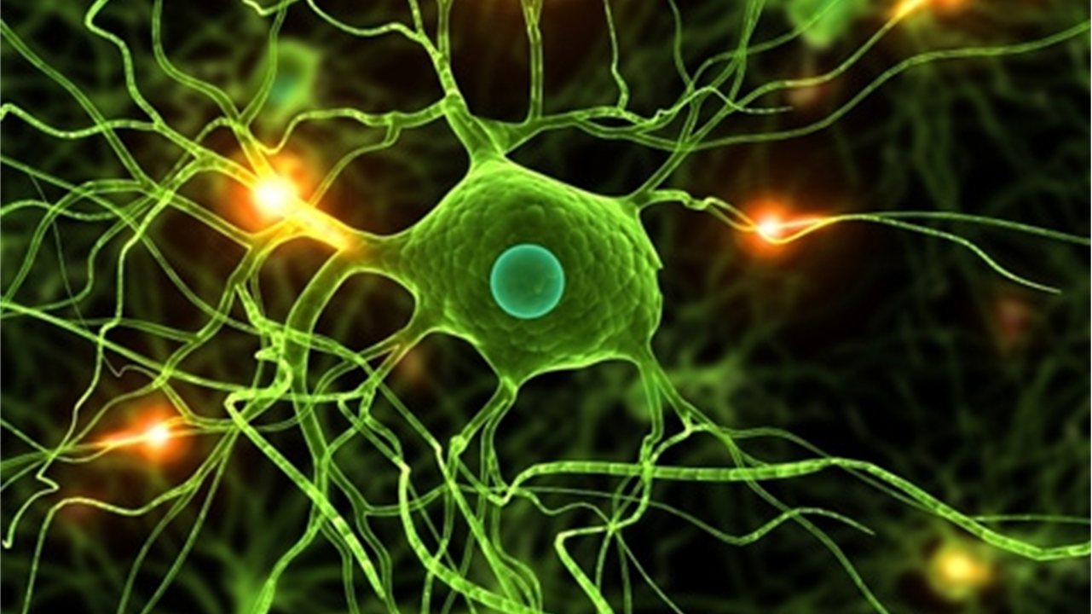

Group 16
Nagib Shah (nsha9343)
Ling Qi (liqi6811)
Young Choi (ycho8487)
Xinan Ma (xima3772)
Protein
post-translational modifications

Slide 2




Overview
Analysis
Evaluation
Validation and Results

Slide 3
Objective
Our objective is to predict unlabelled data, based on partially labelled Akt and mTOR data.
Overview

Slide 4
Description of Data
The given main phosphoproteomics dataset has 12062 rows and 16 columns. Rows are phosphorylation sites and columns are specific characteristics of each phosphorylation site including: Identifier, Seq Window, 15s, 30s, 1m, 2m, 5m, 10m, 20m, 60m, Avg Fold, AUC, Ins 1, Ins 2, LY, MK
22 known Akt substrates were given with there identifiers.
26 known mTOR substrates were given with there identifiers.
Analysis

Slide 5
Feature Extraction
Seq window transformation
Fitting score extration
Analysis

Slide 6
Model Evaluation
Model evaluation results showing GBM and SVM Polynomial are the best models
Evaluation

Slide 7
Model Build
Model evaluation results showing GBM and SVM Polynomial are the best models, so
We built 2 models with different inbalance technic:
SVM – bagging
GBM – boosting
Adaptive sampling
Evaluation

Slide 8
Prediction Outcomes
Results showing GBM is better model based on accuracy on labelled data, any other
Validation/evaluation technic??
Threshold of probability value for Akt: ??? 90% or 80%? Or do we need to consider
Labelled data ranking?
Threshold of probability value for mTOR: ??? 90% or 80%? Or do we need to consider
Labelled data ranking?
Based on above threshold, we got ??? Akt, ??? mTOR
Validation
and
Results

Slide 9
Validation
and
Results

Slide 10
Group Members’ Contribution
Nagib Shah | Data Preparation / Feature Extraction / Feature Selection / Motif / Presentation
Ling Qi | Data Preparation / Model Evaluation / Model Build / Prediction Result / Delta Analysis / Presentation
Young Choi | Prepare Presentation
Xinan Ma | Sourcing references
Validation
and
Results

Slide 11

Group 16
Nagib Shah (nsha9343)
Ling Qi (liqi6811)
Young Choi (ycho8487)
Xinan Ma (xima3772)
THANK YOU

